Slide 1
Cosmology
Physical Sciences
Broward College
Prepared for AST 1002
Horizons in Astronomy

Slide 2
What is Cosmology?
The idea of how the Universe is arranged and how it was created.
Many theological and non-theological ideas were put together on the subject throughout human history.
  Many eastern religions had animals being creator of the Universe.
  Many western religions had gods or one god being the creator of the Universe.
  Many people thought the Universe was always here; a steady-state Universe.
The improvement of astronomical observations and better physical experimentation allowed for a more physical law based theories.
The speed of light was important in looking at the Universe.

Slide 3
What is the speed of light?
3 X 10⁸ m/s
The speed of a photon of light.
Nothing in our matter-dominated universe can go faster than a photon of light.

Slide 4
How did they measure the speed of light?
Galileo Galilei
  Two mirrors method
Michelson - Morely Interferometer
  Fringe method
Modern method
  Two-lengths of fiber-optic
Laser Moon Method
  Laser bounces of a reflector

Slide 5
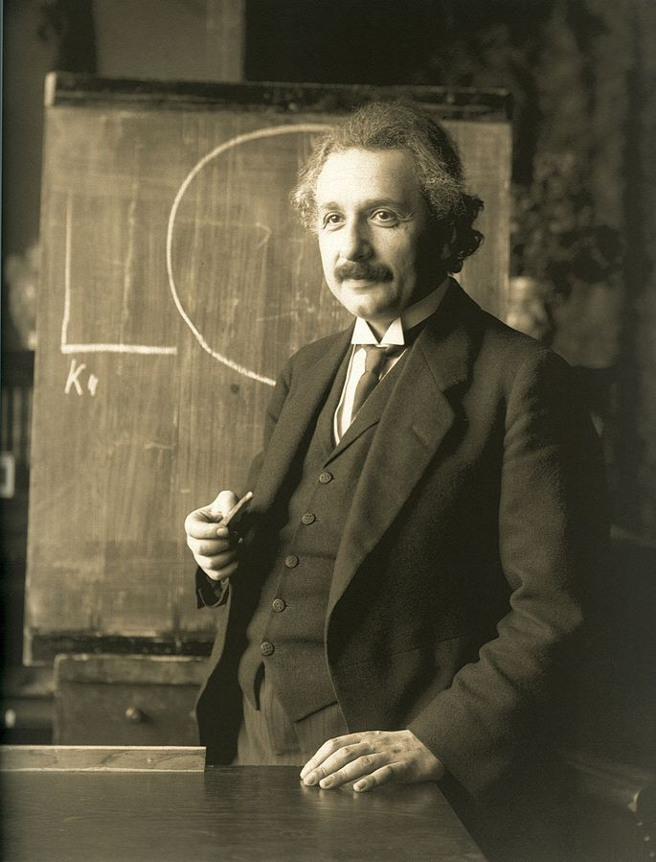
Albert Einstein
1879 – 1955 A.D.
Born in Germany of a business man and wife
Enter Zurich Polytechnic
Worked as a patent clerk after college
Had two wives, Mileva and Elsa.
Worked in Germany until going to US at Princeton.
Figure 1. Albert Einstein (Wiki)

Slide 6
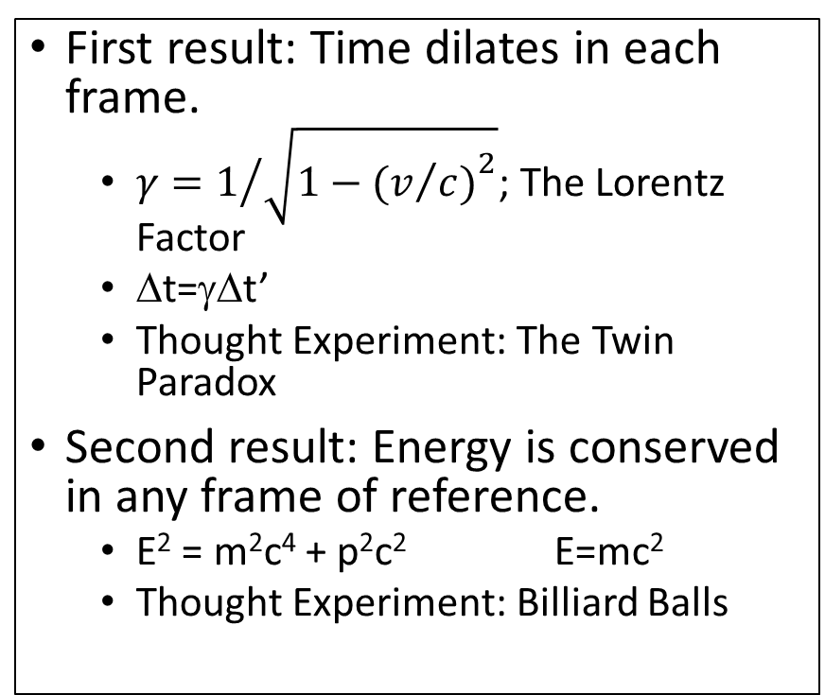
Special Relativity
Special Relativity combined the observations of transformations between different reference (or inertial) and the thought experiments of Einstein.
Two basic postulates:
  The speed of light is the same for all observers, no matter what their relative speed.
  The laws of physics are the same in any inertial frame of reference. This means that the laws of physics observed by a hypothetical observer traveling with a relativistic particle must be the same as those observed whose is stationary in the laboratory
First result: Time dilates in each frame.
  $γ=1/{\sqrt{1−{(v/{c)}}^{2}}}$; The Lorentz Factor
  Δt=γΔt’
  Thought Experiment: The Twin Paradox
Second result: Energy is conserved in any frame of reference.
  E² = m²c⁴ + p²c² E=mc²
  Thought Experiment: Billiard Balls

Slide 7
Time Dilation
A man on a spaceship records a time to be 40 minutes. He is traveling at 0.8c, what time does his friend on Earth?

Slide 8
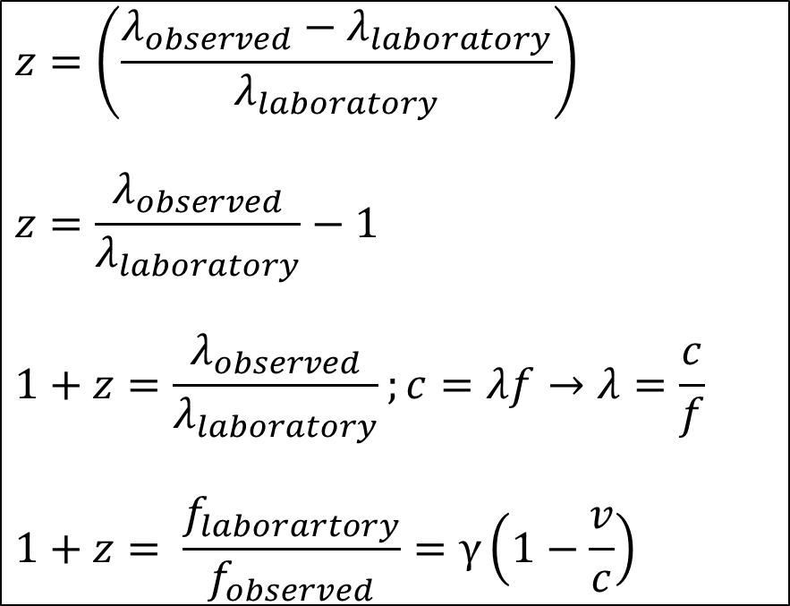
Redshift
Doppler shift is due to the motion of an object. We have observed this shift due to the motion of planets, stars, and galaxies.
To determine redshift or blueshift; we observe the spectra of an object and see the shifts in their spectra as compared to the spectra in the laboratory.
From this shift; we can calculate the redshift or z.
We can play with this in the slide below.
$$z=\left(\frac{λ_{observed}−λ_{laboratory}}{λ_{laboratory}}\right)$$
$$z=\frac{λ_{observed}}{λ_{laboratory}}−1$$
$$1+z=\frac{λ_{observed}}{λ_{laboratory}};c=λf→λ=\frac{c}{f}$$
$$1+z= \frac{f_{laborartory}}{f_{observed}}=γ\left(1−\frac{v}{c}\right)$$

Slide 9
Galactic Redshift
Figure 2. Cosmological Redshift (NASA, 2019)

Slide 10
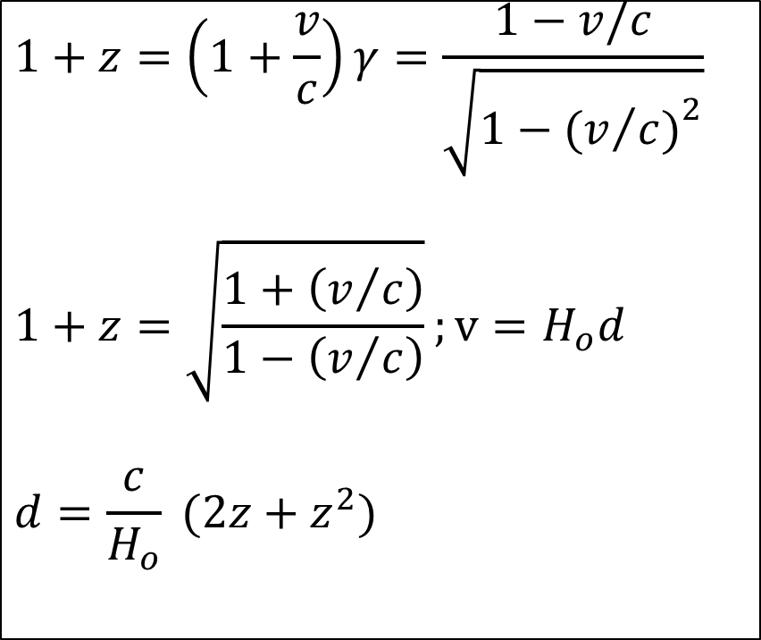
Galactic Redshift
When Lorentz presented his ideas of time dilation, it explained how light was affected over long distances. Hubble had observed redshift in galaxies. So when are combined concept and observation, a relationship between distance and redshift was calculated.
Where v is the recessional velocity of the particle, c is the speed of light, z is the redshift of the object, and H_{o} is the Hubble Constant.
$$1+z=\left(1+\frac{v}{c}\right)γ=\frac{1−v/c}{\sqrt{1−{(v/{c)}}^{2}}}$$
$$1+z=\sqrt{\frac{1+\left(v/c\right)}{1−\left(v/c\right)}};v=H_{o}d$$
$$d=\frac{c}{H_{o}} (2z+z^{2})$$

Slide 11
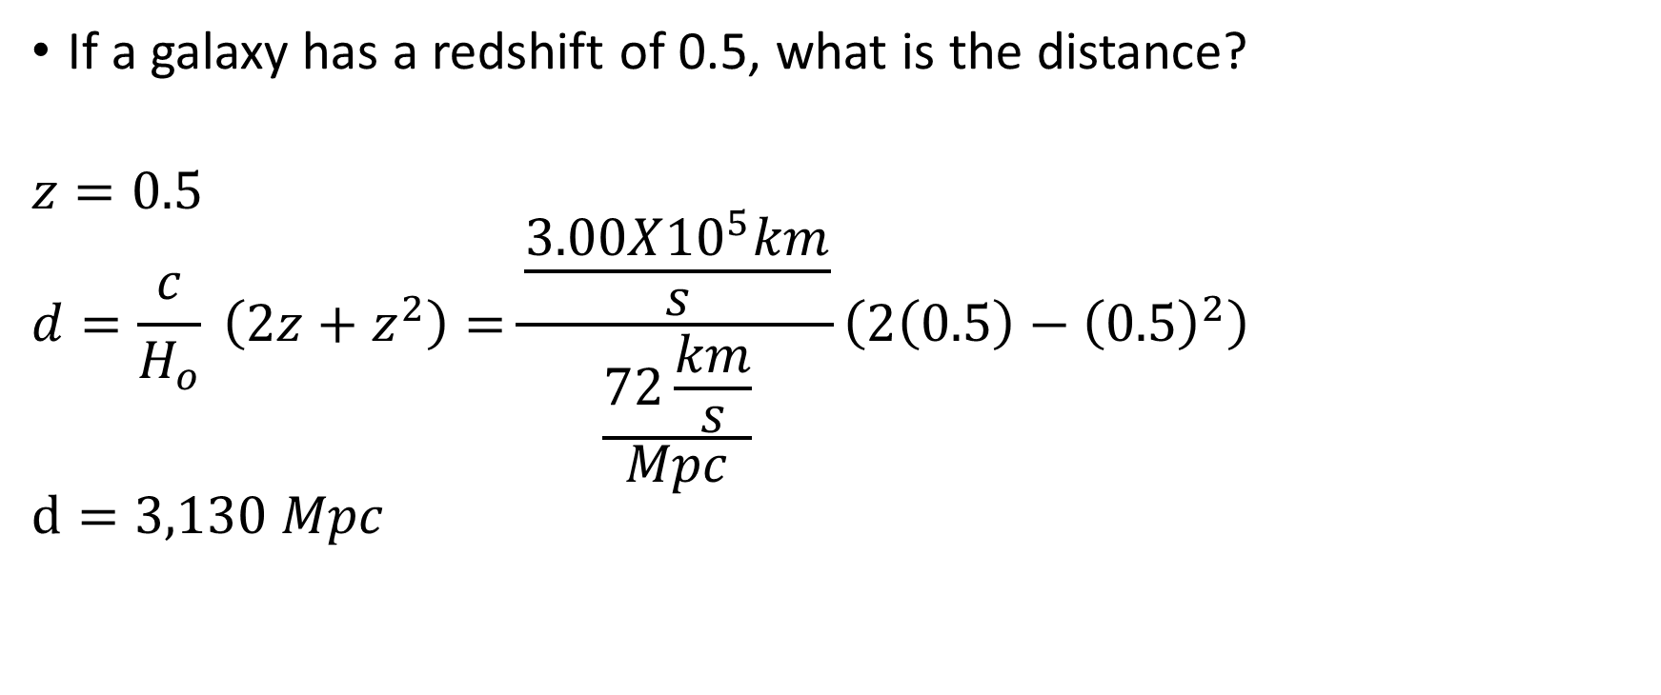
Galactic Redshift Example
If a galaxy has a redshift of 0.5, what is the distance?
$$z=0.5$$
$$d=\frac{c}{H_{o}} \left(2z+z^{2}\right)=\frac{\frac{3.00X{10}^{5}km}{s}}{\frac{72\frac{km}{s}}{Mpc}}\left(2\left(0.5\right)−{\left(0.5\right)}^{2}\right)$$
$$d=3,130 Mpc$$

Slide 12
General Relativity
Newton’s Theory of Gravity
  F=GM₁M₂/d²
Problem: The orbit of Mercury processed around the sun.
  Solution: Einstein imagined that the orbit of Mercury was interacting the highly warped gravitational field.
Equivalence Principle
  If all accelerated systems are equivalent (from special relativity), the Euclidean geometry cannot hold in all of them.
  G_{ab} = 8 πρ T_{ab}
  Where G is the gravitational constant described by Newton, ρ is density of the universe, and T is the stress-energy tensor of the universe.

Slide 13
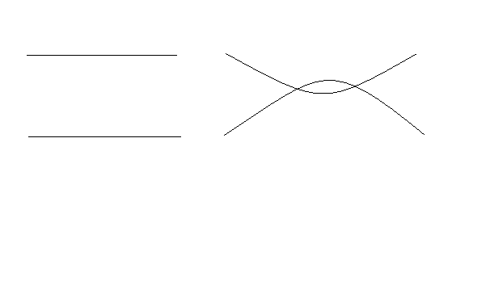

Geometries
Euclidean
Non - Euclidean
Where straight curves are parallel and curves intersect.
Where curves are parallel and straight curves intersect.
Figure 3. Euclidean Geometry
Figure 4. Non-Euclidean Geometry

Slide 14
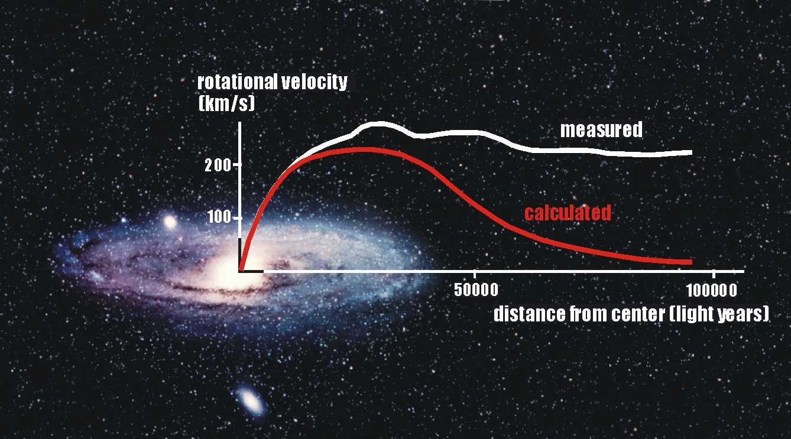
Kepler versus Einstein – The presence of Dark Matter
When we observed gases and dust on the outer edges of galaxies, we see the rotational speeds increase or remain the same; this indicated a presences of an invisible matter, dark matter.
Types:
  Baryonic Material (Neutrinos, etc.)
  MACHOs (Massive Objects in the halos of galaxies)
Figure 5. Rotational Curve of a Galaxy (Rau, 2015)

Slide 15
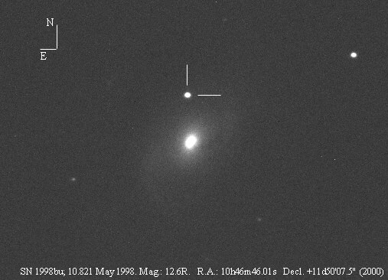
Supernova 1998bu in M 96 – The presence of Dark Energy
A supernova was observed by many astronomers in M 96, a spiral galaxy.
When the photometry was analyzed, the supernova was much further away then expect.
This meant the galaxy was being accelerated away from the Milky Way at a faster rate then first calculated.
This meant a force was present that was accelerating the galaxy, dark energy.
Figure 6. Supernova 1998bu (Masi, 1998)

Slide 16
Hubble and the Gravitational Constant
H – Hubble Constant
G – Gravitational Constant
ρ – density of the Universe
k – curvature of the Universe (1,0,-1)
a – expansion rate of the Universe
Λ – the cosmological constant of the Universe

Slide 17
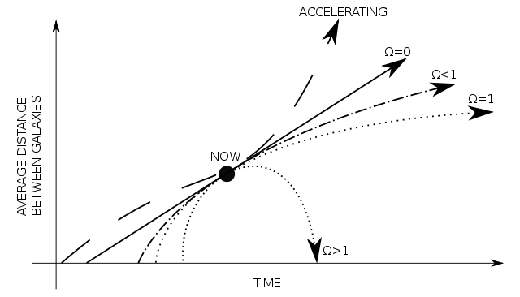
The Fate of the Universe
Heat Death
Flat Universe
The Big Crunch
Figure 7. Fate of the Universe (Wiki)

Slide 18
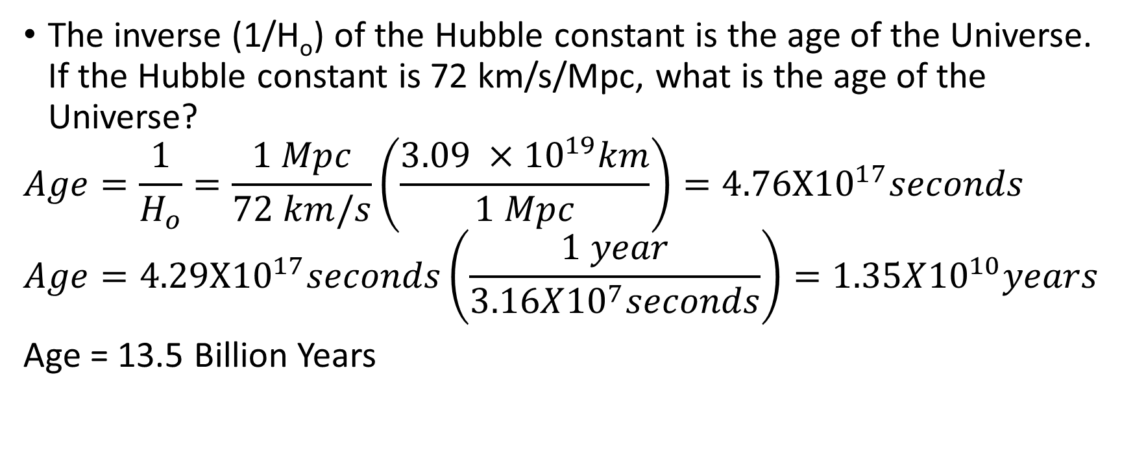
Age of the Universe
The inverse (1/H_{o}) of the Hubble constant is the age of the Universe. If the Hubble constant is 72 km/s/Mpc, what is the age of the Universe?
$$Age=\frac{1}{H_{o}}=\frac{1 Mpc}{72 km/s}\left(\frac{3.09 ×{10}^{19}km}{1 Mpc}\right)=4.76X{10}^{17}seconds$$
$$Age=4.29X{10}^{17}seconds\left(\frac{1 year}{3.16X{10}^{7}seconds}\right)=1.35X{10}^{10}years$$
Age = 13.5 Billion Years

Slide 19
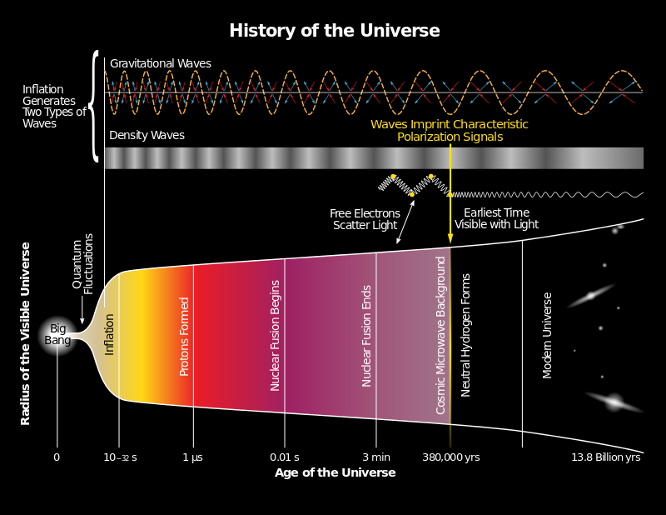
The Big Bang
The theory that everything we know started with one, energetic explosion of energy.
The explosion created the four forces and all the matter we see today.
The theory is support by three key pieces of evidence:
  Observations of little or no anti-matter
  Present Elemental Abundances
  Presence of the Cosmic Background Radiation
Figure 8. The Big Bang Theory (Wiki)

Slide 20
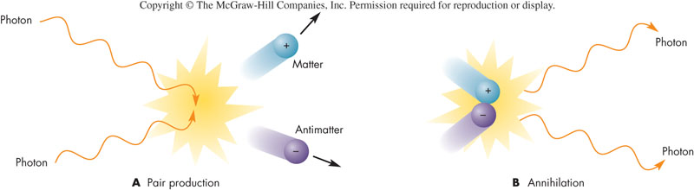
Matter Recombination
The Universe had equal matter and antimatter in the early stages. Matter and anti-matter interacted creating energy. This interaction inflated the Universe.
Figure 8. Matter/Anti-Matter Interaction (Fix, 2004)

Slide 21
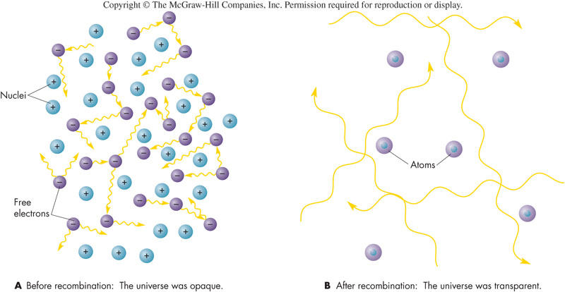
The Dark Ages, Clearing the Universe
Much of this recombined and created the background radiation leaving the Universe empty enough to allow quarks to create the matter we know today.
Figure 10. Before and After Recombination (Fix, 2004)

Slide 22
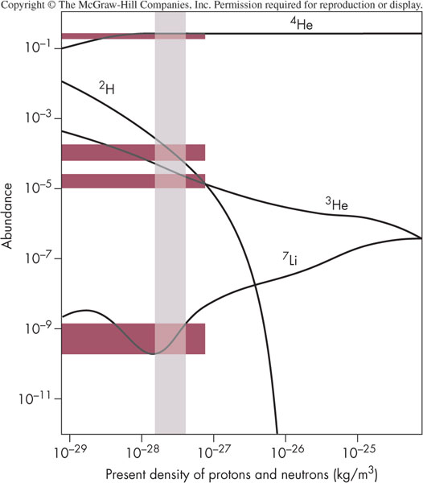
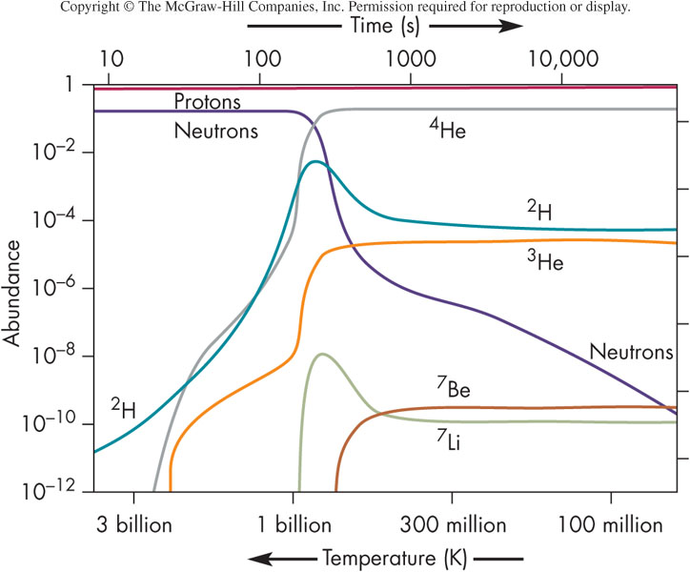
Elemental Creations
As the universe emptied from recombination; the quarks combined to create protons and neutrons. These combined to create hydrogen then helium. The other elements came from these combinations.
Figure 11. Elemental Creations due to density (Fix, 2004)
Figure 11. Elemental abundance versus time (Fix, 2004)

Slide 23
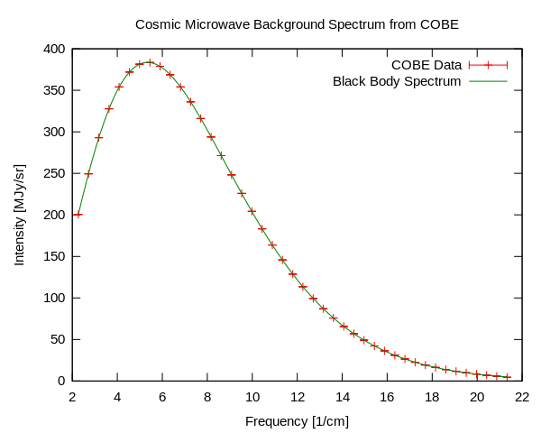
Cosmic Background Temperature
As the Universe emptied, it became cooler. It continued this trend when the first stars and galaxies formed out of the matter.
The current temperature of the Universe is 3 degrees Kelvin. We have observed this temperature using probes and radio receivers. We have created Wien’s curve and found the peak indicates 3 degrees Kelvin.
The Big Bang Theory also predicted this background temperature for the Universe.
Figure 13. Blackbody Curve of the Cosmic Background Radiation. (Wiki)

Slide 24
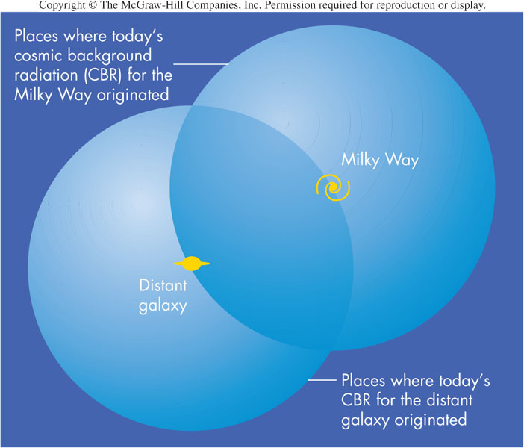
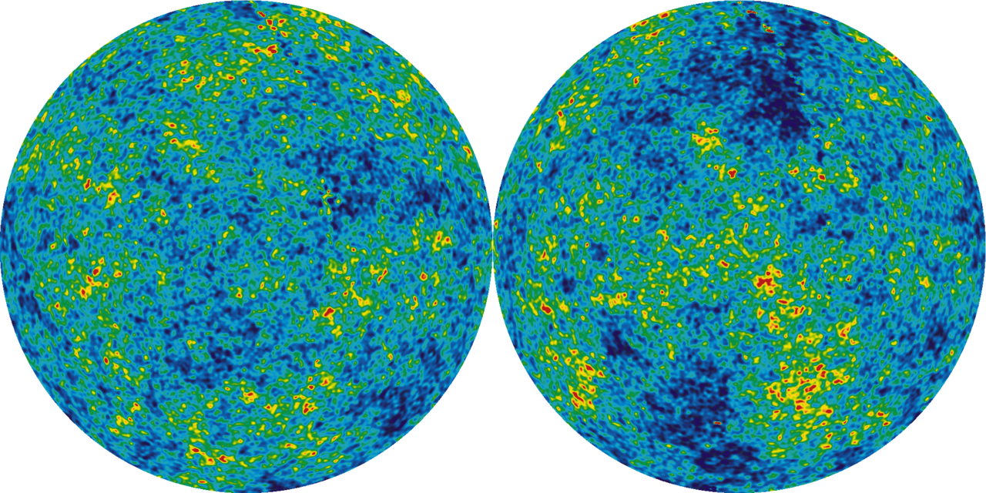
Cosmic Microwave Background (CMB)
The “Scars” in the CMB are created when a black hole is created due to a death of a supermassive black hole.
We observed this in the CMB via probes like Wilkinson Aniostropy Probe (WMAP).
Figure 14. Creation of a Galaxy (Fix, 2004)
Figure 15. The CMB (Wiki)

Slide 25
Current State of Universe
Composition
  70% Dark Energy (?)
  24% Dark Matter (Neutrinos, Planets)
  4% Light Matter (Stars, Galaxies)
Hubble Constant = 72 km/s/Mpc
k = 1 or accelerating in its expansion

Slide 26
Book/Course Images
Fix, J. D. (2004) Astronomy: Journey to the Cosmic Frontier, New York, McGraw-Hill Higher Education.
Masi, G. (1998) Retrieved from: http://www.bellatrixobservatory.org/m96b.jpg
NASA, ESA, and Husak, L. (STScI) (2019) Cosmological Redshift, Retrieved from: https://www.nasa.gov/feature/goddard/2019/nasa-s-webb-to-explore-galaxies-from-cosmic-dawn-to-present-day
Rau, W. (2015) Dark Matter Retrieved from: http://cdms.phy.queensu.ca/Public_Docs/DM_Intro.html

Slide 27
Wiki Commons/Wikipedia Image References
Big Bang Theory: "History of the Universe" by Yinweichen - Own work. Licensed under CC BY-SA 3.0 via Wikimedia Commons - https://commons.wikimedia.org/wiki/File:History_of_the_Universe.svg#/media/File:History_of_the_Universe.svg
Blackbody of the Cosmic Background Radiation: "Cmbr" by Quantum Doughnut - Own work. Licensed under Public Domain via Wikimedia Commons - https://commons.wikimedia.org/wiki/File:Cmbr.svg#/media/File:Cmbr.svg
Einstein: "Einstein 1921 by F Schmutzer - restoration" by Ferdinand Schmutzer - http://www.bhm.ch/de/news_04a.cfm?bid=4&jahr=2006 [dead link], archived copy (image). Licensed under Public Domain via Wikimedia Commons - https://commons.wikimedia.org/wiki/File:Einstein_1921_by_F_Schmutzer_-_restoration.jpg#/media/File:Einstein_1921_by_F_Schmutzer_-_restoration.jpg
Fate of the Universe: "Universe" by Durand - Based on gif version uploaded by Dpeinador. Licensed under Public Domain via Wikimedia Commons - https://commons.wikimedia.org/wiki/File:Universe.svg#/media/File:Universe.svg
The CMB: "WMAP 2008 ILC ecliptic" by NASA / WMAP Science Team - LAMBDA WMAP Images; [1]. Licensed under Javna last via Wikimedijina Zbirka - https://commons.wikimedia.org/wiki/File:WMAP_2008_ILC_ecliptic.png#/media/File:WMAP_2008_ILC_ecliptic.png

